Slide 1

Raptor V3 Lite
Pure Form. Simplified Deployment.

Slide 2
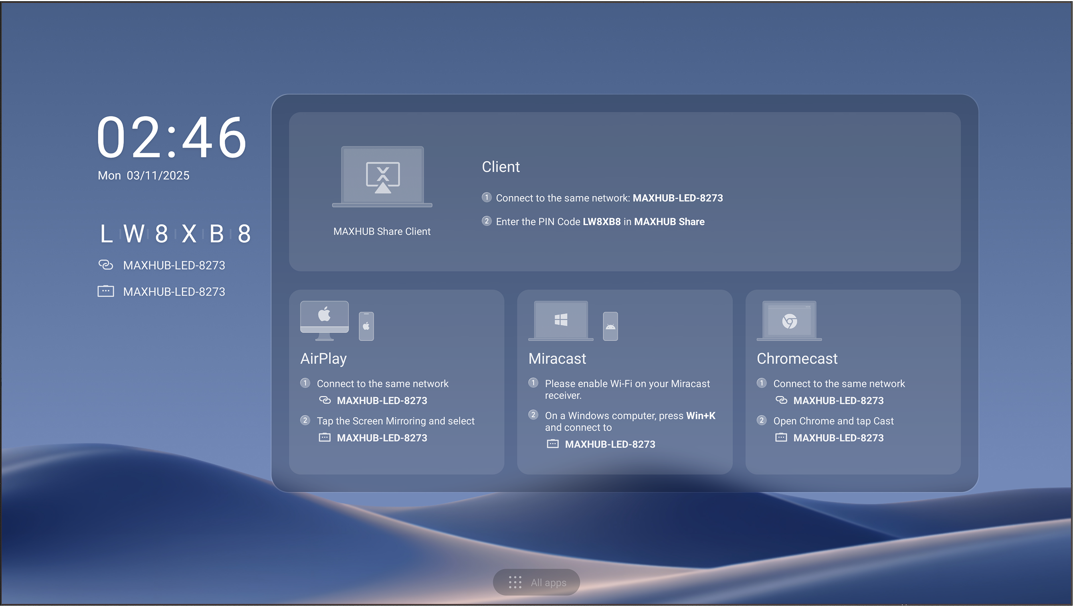
Ultra-Slim, Lightweight, and Ready for Rapid Deployment
1699.5mm
3012mm
Notes:
1.配图---应该是阶梯教室

Slide 3
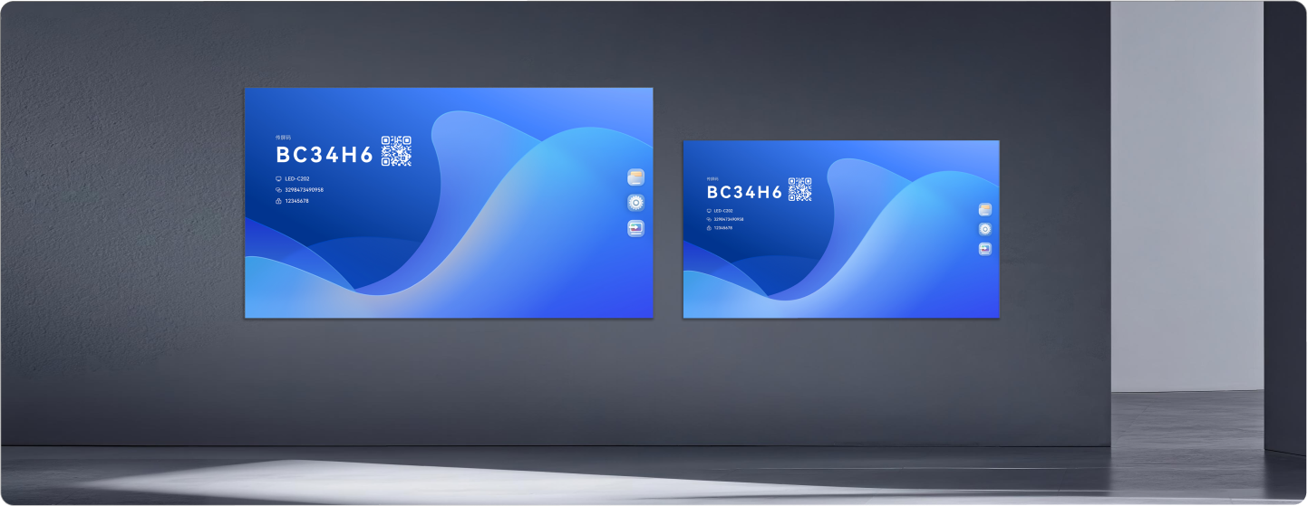
More Size Options for Different Spaces
Delivers accurate color reproduction, high contrast, and a wide viewing experience for clear, consistent indoor presentation.
Notes:
1.配图---应该是阶梯教室

Slide 4
Minimalism, Inside Out
98.8% Display Area · Highly Integrated Self-Developed Hub Board · Ultra-Narrow Bezel
6mm
6mm
LVDS Connection
3-In-1 Hub Board
98.8% Display Area
6mm Ultra-Narrow Bezel
Notes:
1.配图---应该是阶梯教室

Slide 5
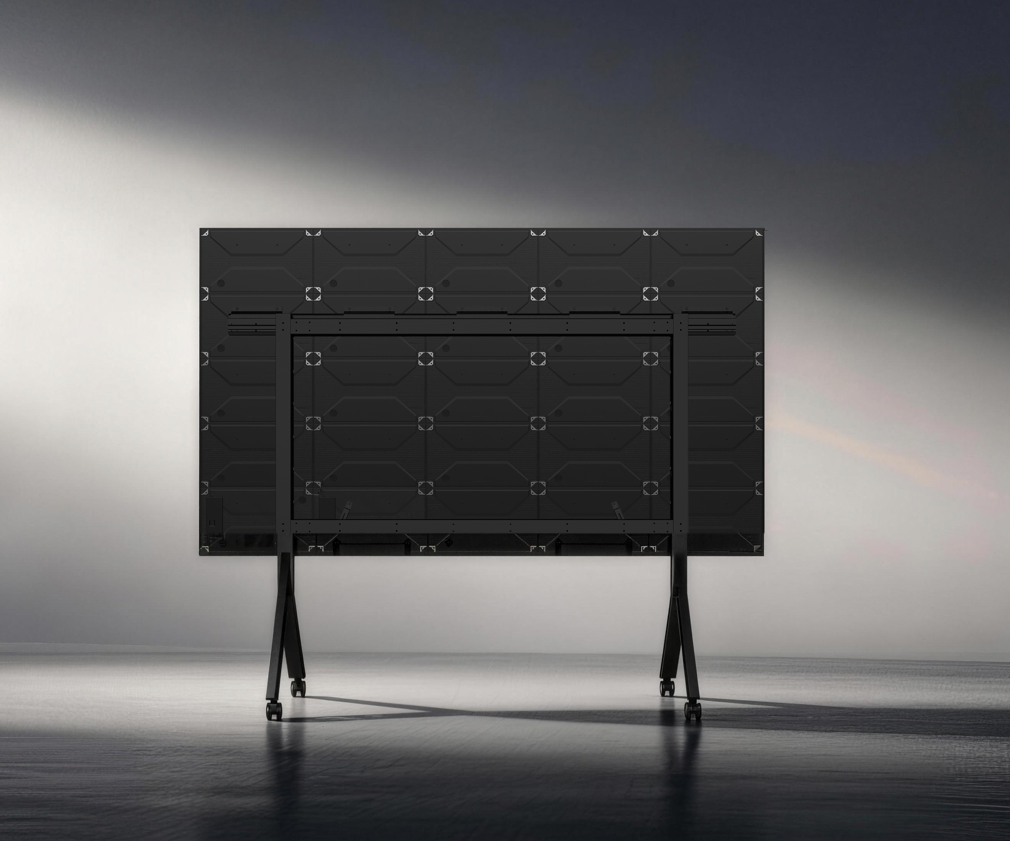
Integrated Design for Simpler Large-Format Deployment
By integrating the control system and power supply directly into the cabinet, Raptor V3 lite enables true single-cable power connection for a cleaner setup and simpler installation.
Invisible Bottom Control Bar
Break free from visual boundaries with a true bezel-less design on all four sides
Notes:
Raptor V3 lite 将控制系统和电源直接集成到机柜中，实现了真正的单电缆电源连接，从而实现了更简洁的设置和更简单的安装。
四边均采用真正的无边框设计，打破视觉界限

Slide 6
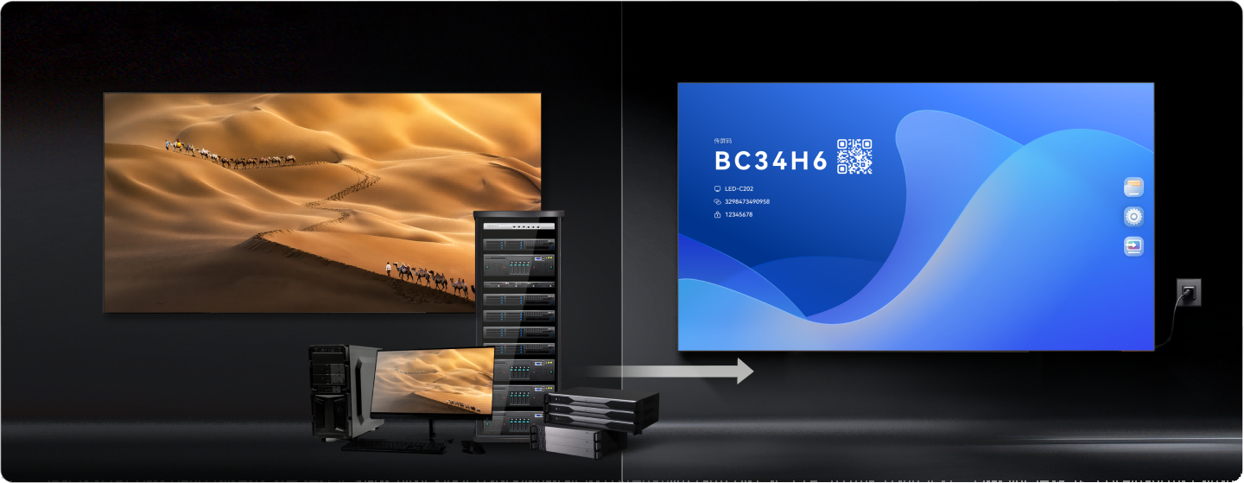
All-in-One Simplicity Without External Devices
Operate with just a power cable, without the complexity of external control devices and bulky cabling.
Complex Cabling Between Devices Large Space
Bringing the ease of an all-in-one experience to larger engineering display applications
Notes:
只需一根电源线即可操作，无需外部控制设备和笨重的电缆，非常复杂。

Slide 7
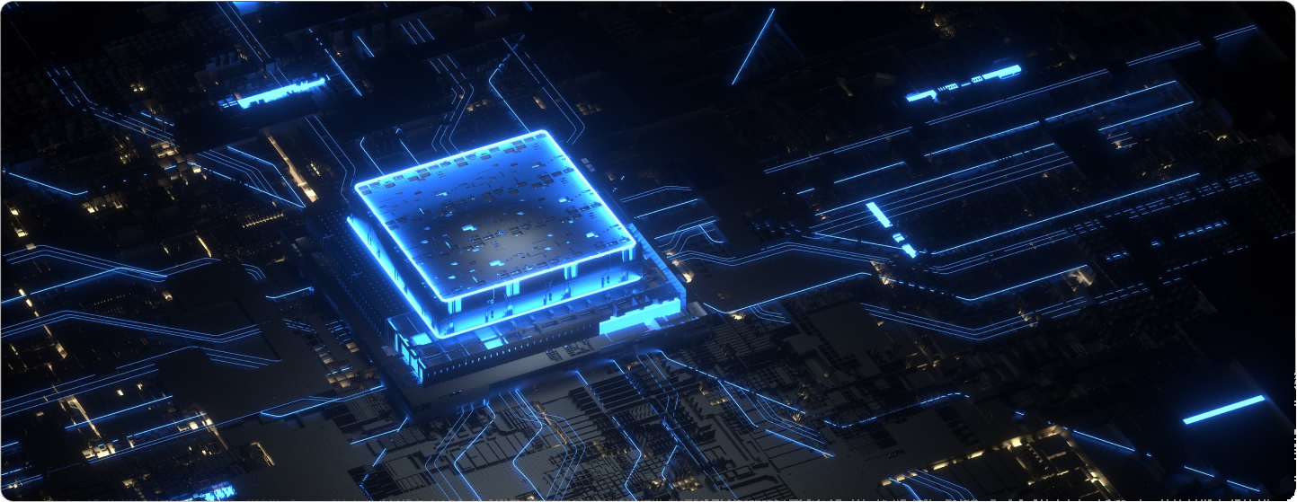
Powerful Performance for Smooth Operation
An octa-core CPU architecture and integrated embedded hardware engines ensure smooth, stable performance across professional indoor applications.
4GB RAM | 64GB Storage
Android 13.0 OS
Notes:
1.配图---应该是阶梯教室

Slide 8
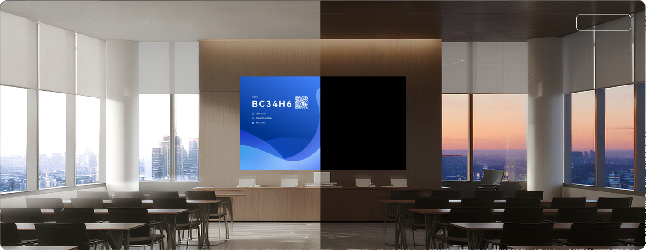
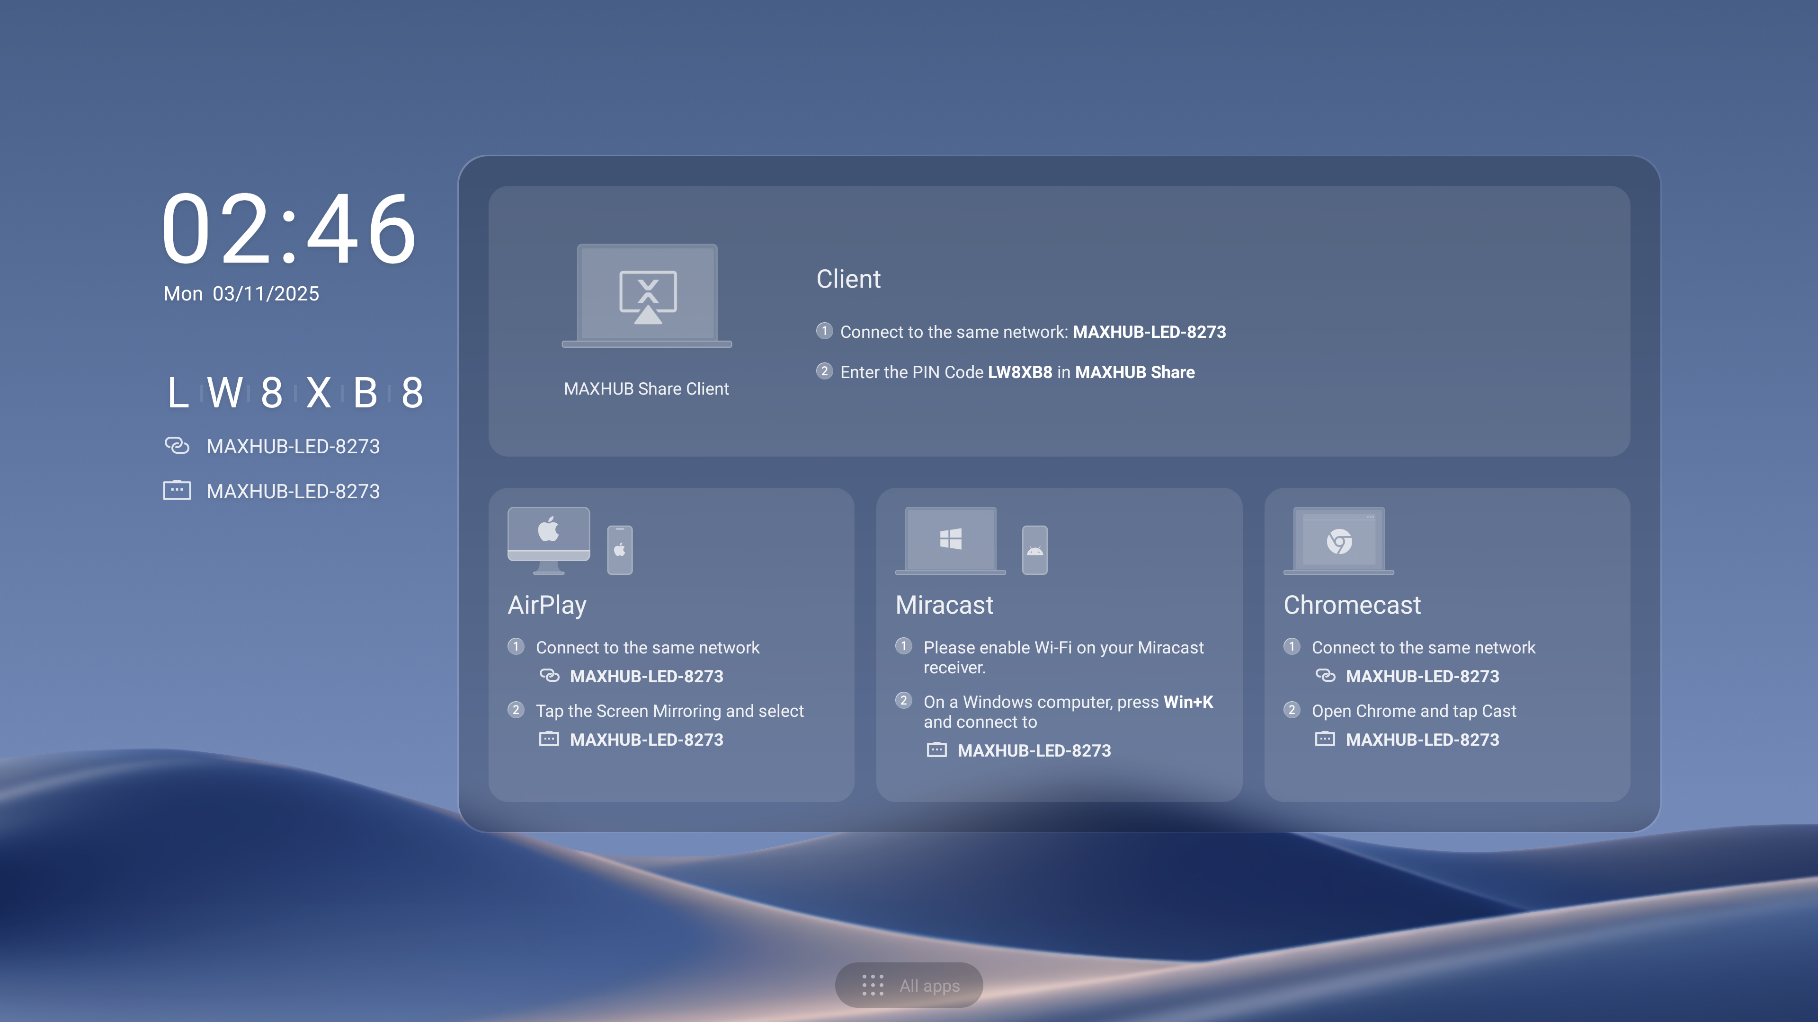
Ultra-Low Standby Power for Long-Term Efficiency
Through in-house board, circuit, and driver design, Raptor V3 lite achieves standby power consumption of ≤0.5W, helping reduce long-term operating costs.
Sleep Mode
Notes:
1.配图---应该是阶梯教室

Slide 9

Reliable & Stable Signal Transmission
Internal LVDS connections enhance anti-interference performance and signal stability, helping ensure consistent display output in demanding indoor environments.
Notes:
1.配图---应该是阶梯教室

Slide 10
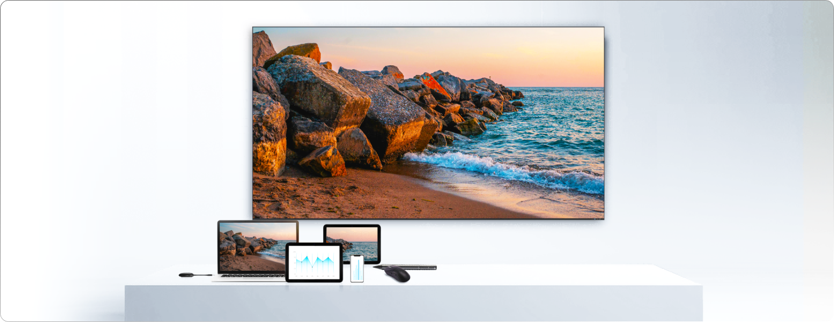
Seamless Smart Peripherals
Supports low-latency wireless connection and fast peripheral pairing for more convenient daily operation.
Notes:
1.配图---应该是阶梯教室

Slide 11
Effortless Expansion
Easily handles multi-device input needs for meeting rooms, showrooms, classrooms, and commercial spaces, enabling efficient and seamless content switching and presentations.
HDMI IN × 2 | USB 3.0 × 2 | Audio out | RS232 | RJ
Notes:
轻松满足会议室、展厅、教室和商业空间的多设备输入需求，实现高效、无缝的内容切换和演示。

Slide 12
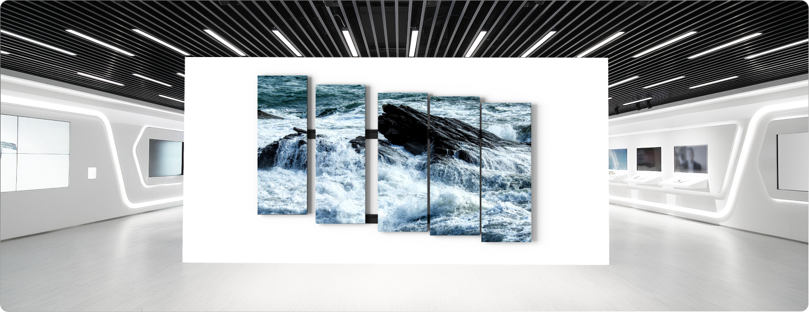
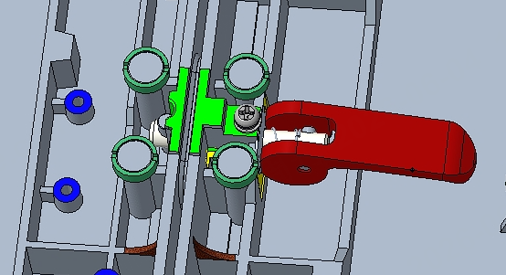
Minimalism, Inside Out
98.8% Display Area · Highly Integrated Self-Developed Hub Board · Ultra-Narrow Bezel
31mm Ultra-Thin Cabinet
Delivery in Columns
No Steel Structure
Quick lock
Notes:
1.配图---应该是阶梯教室

Slide 13
Simple Interaction, User Friendly
New lightweight launcher provides quick access to key functions: media playback, wireless casting, source switching (Android, HDMI1, HDMI2), and system settings.
Notes:
全新的轻量级启动器可快速访问关键功能：媒体播放、无线投屏、信号源切换（Android、HDMI1、HDMI2）和系统设置。

Slide 14

True-to-Life Visual Performance
Delivers accurate color reproduction, high contrast, and a wide viewing experience for clear, consistent indoor presentation.
105%Wide Gamut Full Flip-Chip COB 16:9 Aspect Ratio 1296P* 15,000:1 Contrast Ratio** 170°Wide Viewing Angle***
* COB 162 inch 1296P, others 1080p
**COB 15,000:1, SMD 6,500:1
***COB 170/170, SMD: 160/160
Notes:
添加2K，对比度和170度的说明

Slide 15
Specifications
Raptor V3 Lite
Model
Size(inch)
Overall Size（mm）
Net weight(kg)
Resolution(px)
Contrast Ratio
Gray Scale (bit)
Refresh Rate(Hz)
Brightness (nit)
Viewing Angle (H/V)
Input and output interface
Operating system
Cabinet material
Installation method
Maintenance method
Recommended viewing distance(m)
LP135F07(SMD)
135
3012*1699.5*31
95
1920*1080
6500:1
13+4bit
3840
100~550(Adjustable)
160°/160°
≥3.2m
LP162F07(SMD)
162
3612*2037×31
126.8
1920*1080
6500:1
13+4bit
3840
100~550(Adjustable)
160°/160°
≥3.8m
LP135V07C(COB)
135
3012*1699.5*31
95
1920*1080
15000:1
13+6bit
3840
100~600(Adjustable)
170°/170°
≥3.2m
LP162V12C(COB)
162
3612*2037×31
126.8
2304*1296
15000:1
13+6bit
3840
100~600(Adjustable)
170°/170°
≥3.2m
Input：HDMI 2.0 × 1, HDMI 1.4 × 1, USB 3.0 *2 Output：3.5mm Audio out *1 RS232*1
Android 13.0, 4GB RAM, 64GB Storage, Quad-core Cortex-A76 + Quad-core Cortex-A55 @ 2.4GHz
Die-Cast Aluminum
Stand, Wall Mount, Ceiling Mount
Front-maintenance
Notes:
1.配图---应该是阶梯教室

Slide 16
Thanks
www.maxhub.com
sales@maxhub.com
MAXHUB_Global

